Slide 1
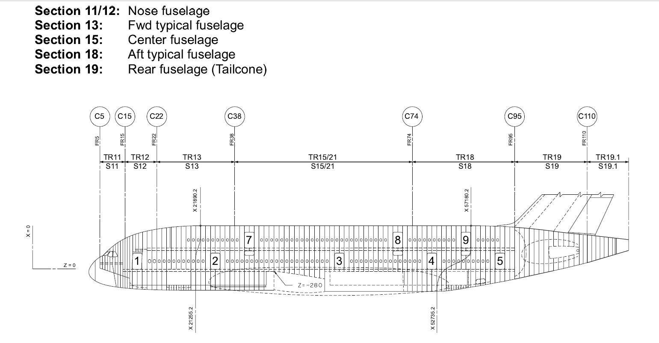
X=5373.0
X=16205.2
X=26365.2
X=49530.0
X=62865.0
X=72320.0

